Slide 2
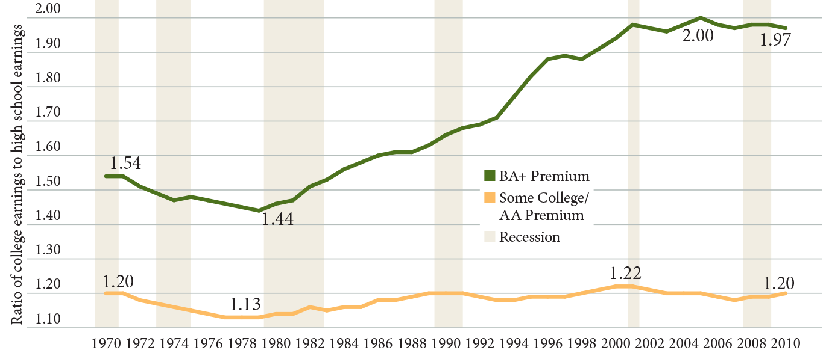
The College Earnings Premium
Source: Carnevale, Jayasundera, and Cheah (2013)

Slide 3
Employers Prioritize Innovation and Transferable Skills
Source: Hart Research Associates, It Takes More Than a Major (2013)

Slide 4
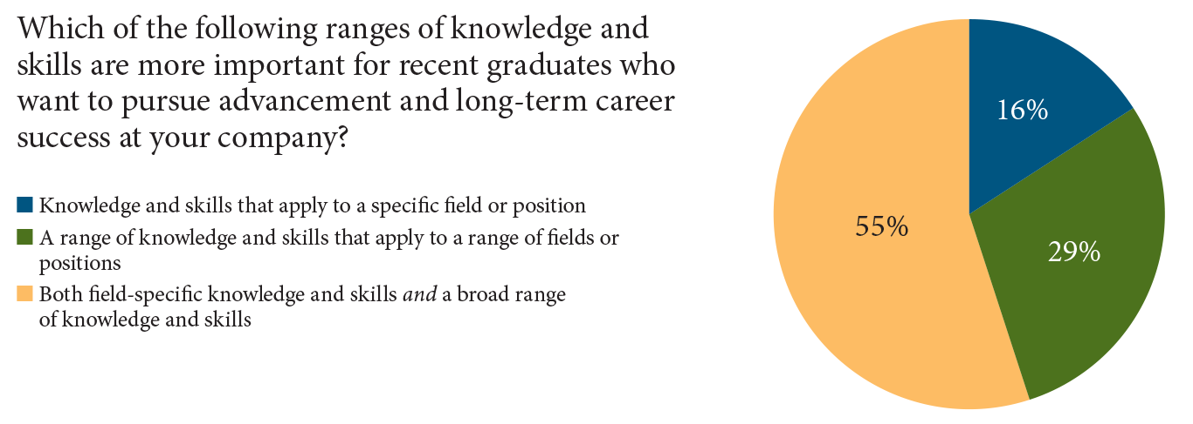
Employers Want Both Broad Knowledge and Specific Skills
Source: Hart Research Associates, It Takes More Than a Major (2013).

Slide 5
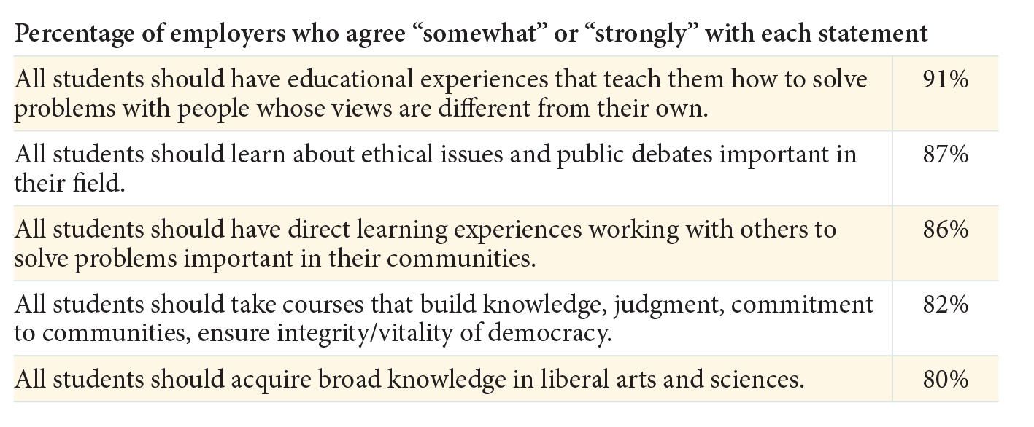
Employers Support Liberal Arts, Diversity, and Civic Learning
Source: Hart Research Associates, It Takes More Than A Major (2013).

Slide 6
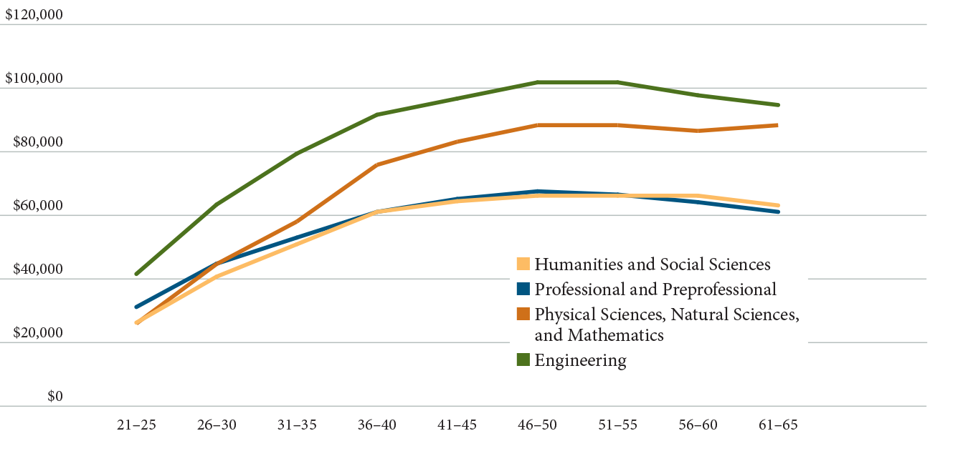
Median Annual Earnings by Age-Group and Undergraduate Major (2010-11)
Source: How Liberal Arts and Sciences Majors Fare in Employment. 2013

Slide 7
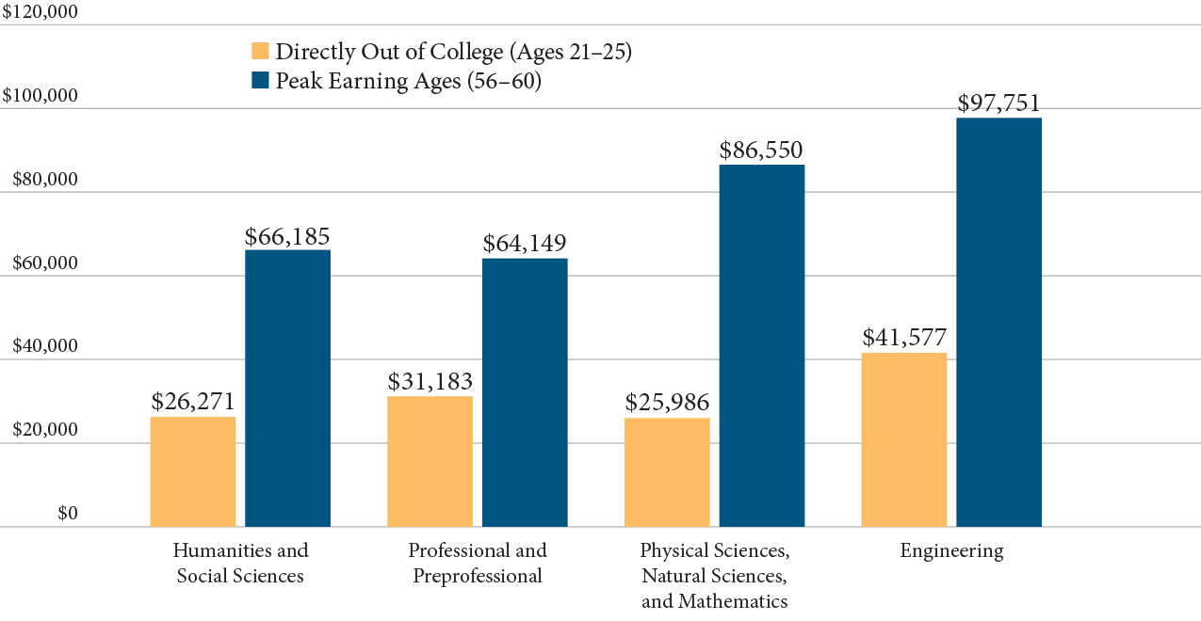
Short-term vs. Long-term Earnings (2010-11)
Source: How Liberal Arts and Sciences Majors Fare in Employment. 2013

Slide 8
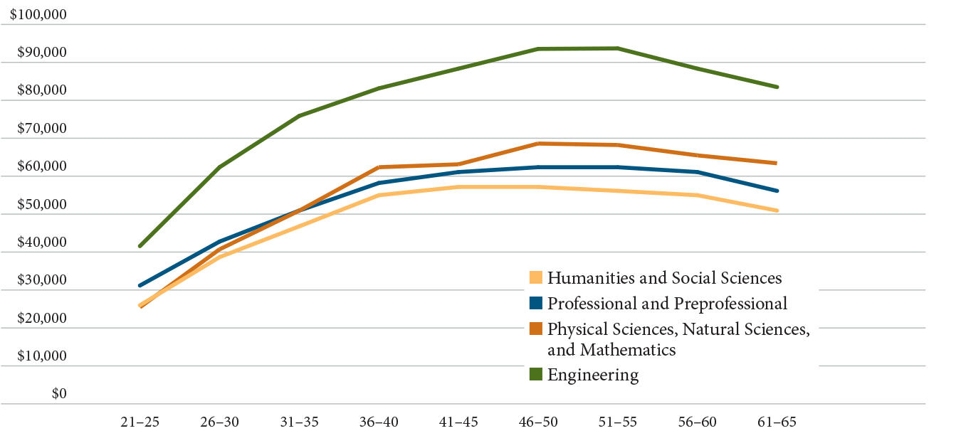
Median earnings for graduates with only baccalaureate degrees (2010-11)
Source: How Liberal Arts and Sciences Majors Fare in Employment. 2013

Slide 9
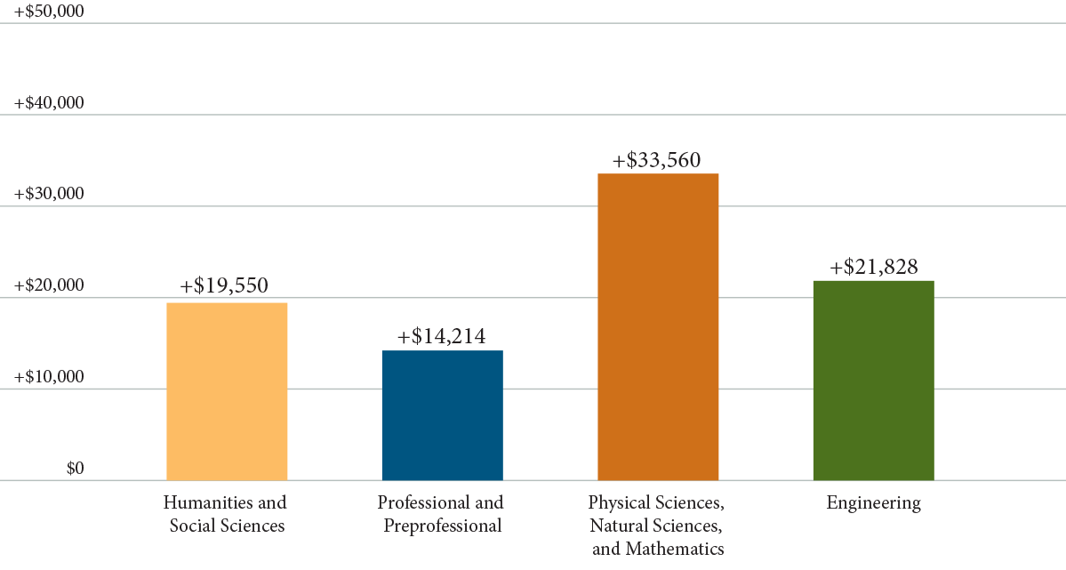
The Graduate School Earnings Bump
Source: How Liberal Arts and Sciences Majors Fare in Employment. 2013

Slide 10
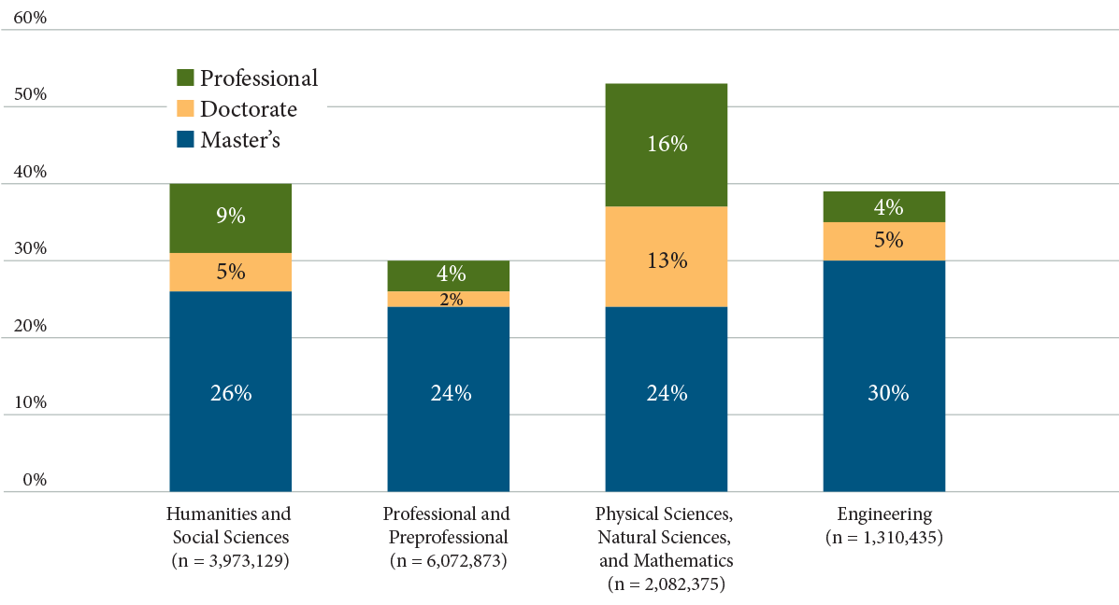
Graduate and Professional Degree Attainment
Source: How Liberal Arts and Sciences Majors Fare in Employment. 2013

Slide 11
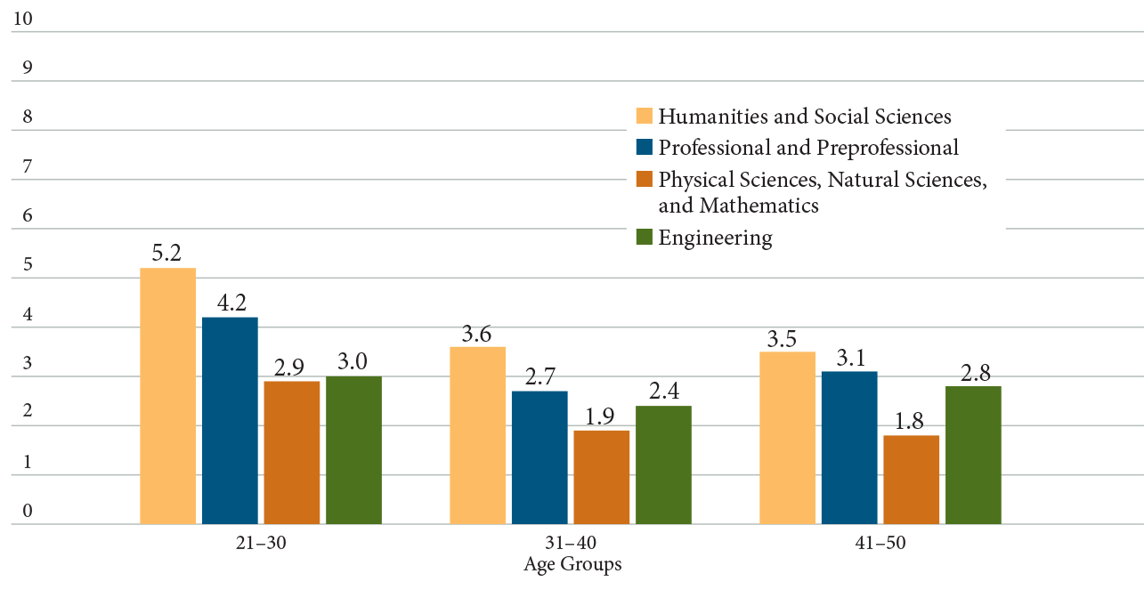
College Graduate Unemployment Rates
Source: How Liberal Arts and Sciences Majors Fare in Employment. 2013

Slide 12
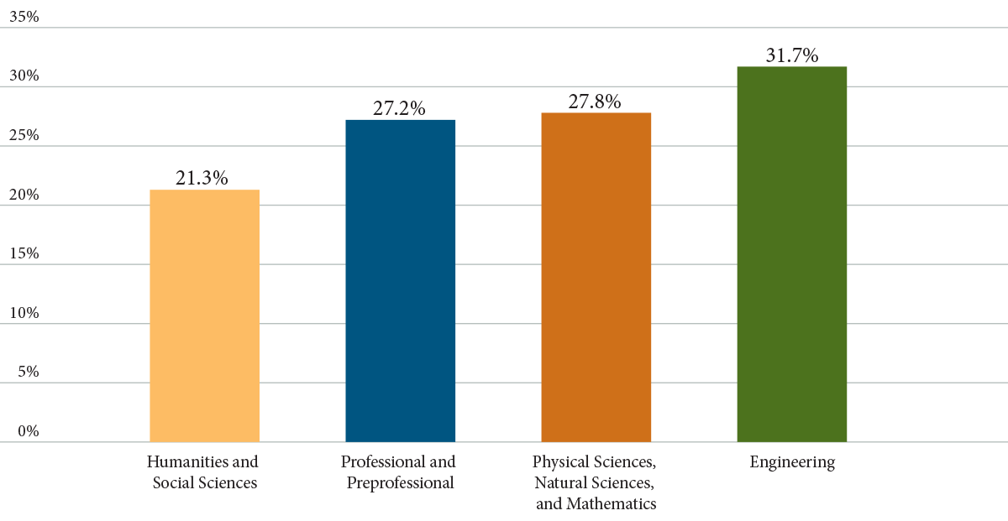
Percentages of Graduates in Top 5 Professions
Source: How Liberal Arts and Sciences Majors Fare in Employment. 2013

Slide 13
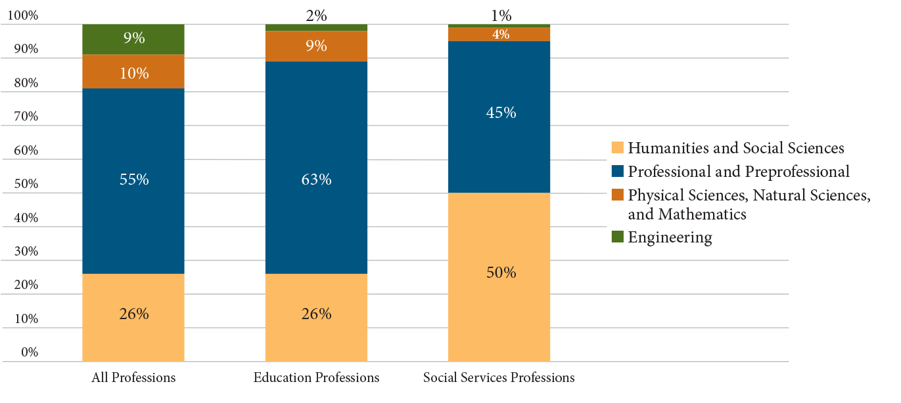
College Graduates in Education and Social Services Professions (2010-11)
Source: How Liberal Arts and Sciences Majors Fare in Employment. 2013
Note: For this study, the category of “social services professions” includes counselors; social workers; social and human/community service assistants, managers, and specialists; clergy and other religious workers; and similar categories.

Slide 14
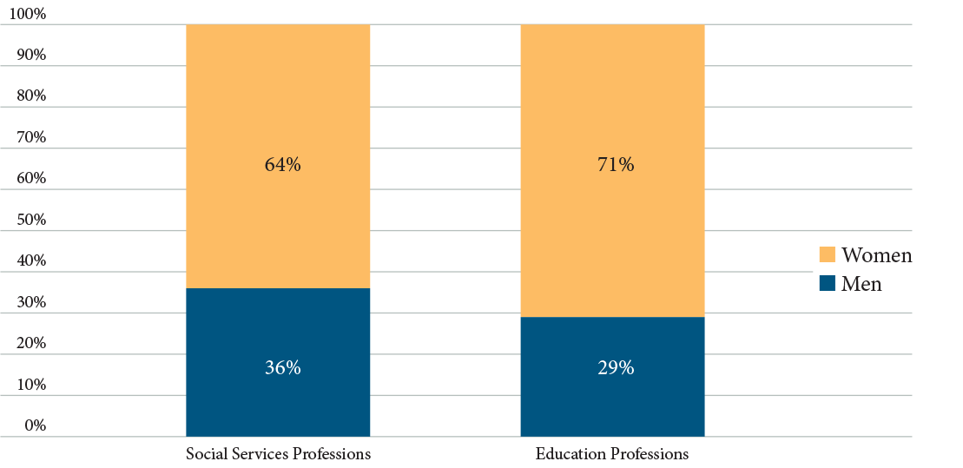
Women Overrepresented in Education and Social Services Professions (2010-2011)
Source: How Liberal Arts and Sciences Majors Fare in Employment. 2013
Note: For this study, the category of “social services professions” includes counselors; social workers; social and human/community service assistants, managers, and specialists; clergy and other religious workers; and similar categories.

Slide 15
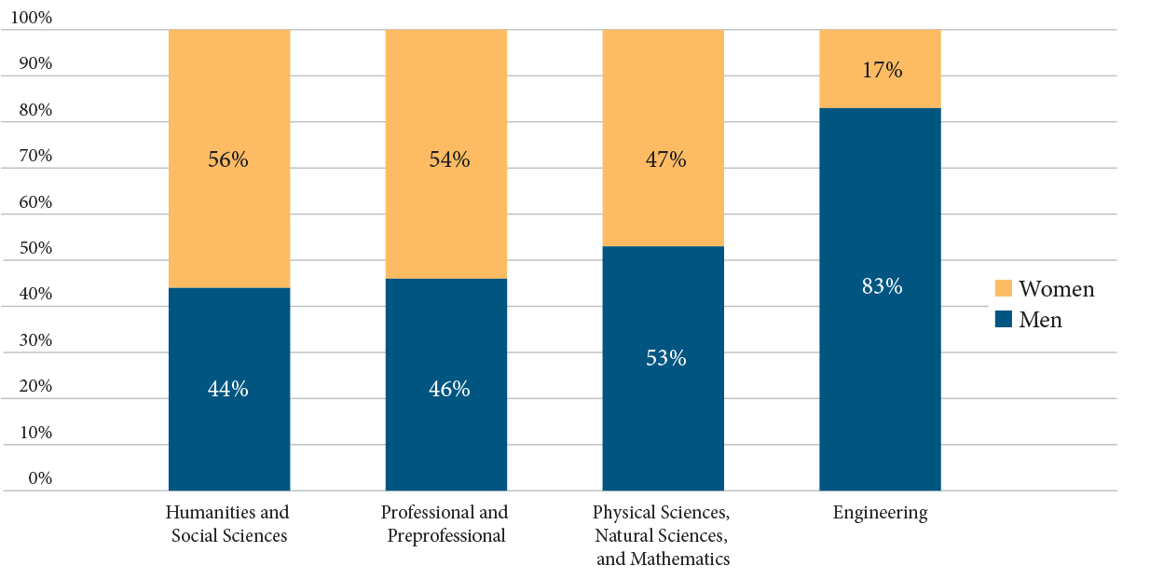
Percentage of Men and Women Ages 21-40 with Four-Year Degrees (2010-2011)
Source: How Liberal Arts and Sciences Majors Fare in Employment. 2013

